Slide 1
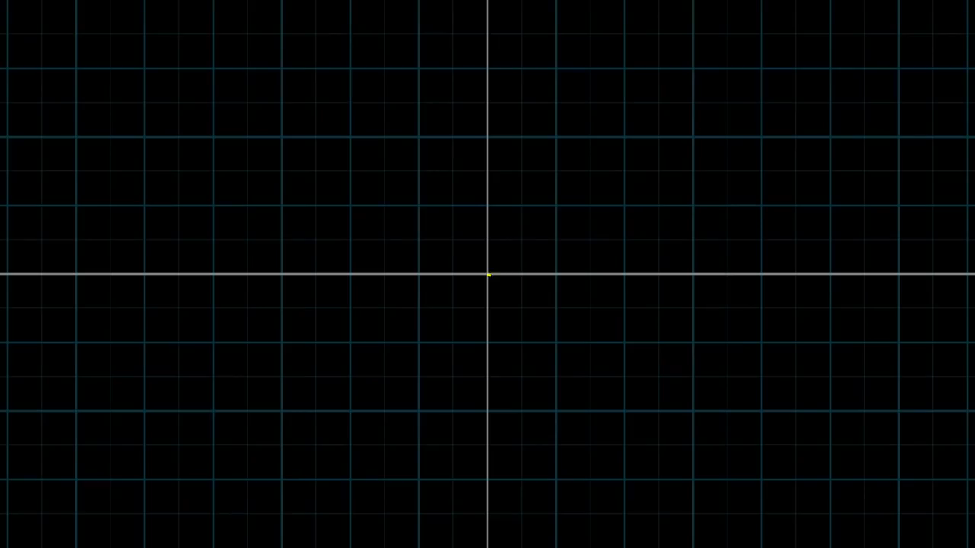
Basis of a Vector [3,-2]

Slide 2
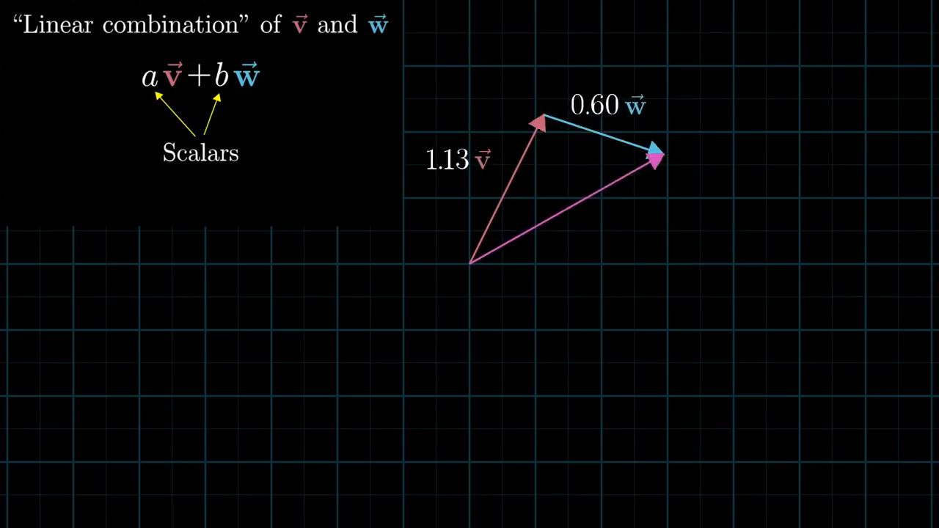
Span of a Vector

Slide 3
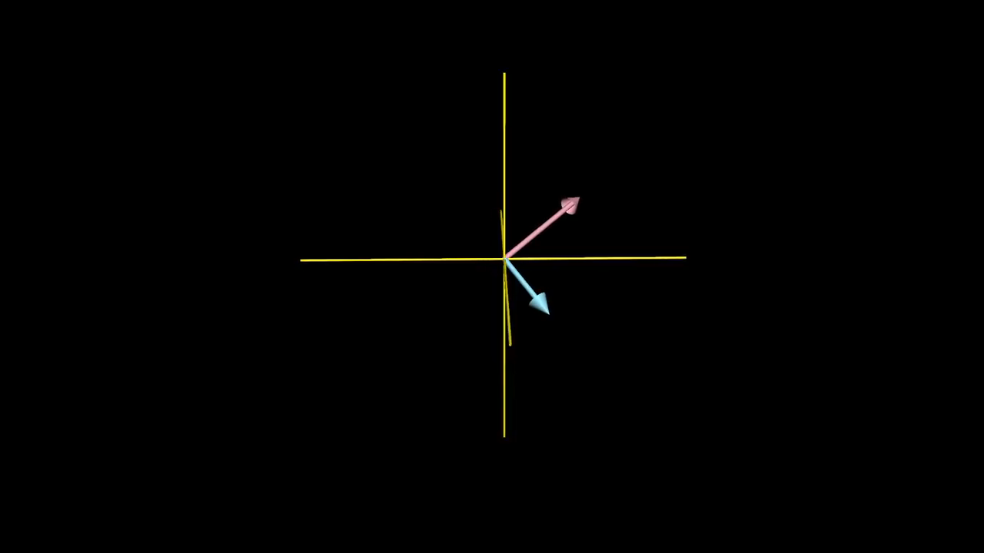
Span of a Vector (3D)

